Slide 1

Lecture 1 Introduction

Slide 2
Thinking in Objects
You can walk into a computer store and, with a little background and often some help, assemble an entire PC from various components: a motherboard, a CPU chip, a video card, a hard disk, a keyboard, and so on.
Ideally, when you finish assembling all the various self-contained units, you have a system in which all the units work together to create a larger system with which you can solve the problems you bought the computer for in the first place.

Slide 3
Internally, each of those components may be vastly complicated and engineered by different companies with different methods of design. But you don't need to know how the component works, what every chip on the board does, or how, when you press the ‘A’ key, an ‘A’ gets sent to your computer. As the assembler of the overall system, each component you use is a self-contained unit, and all you are interested in is how the units interact with each other.

Slide 4
Will this video card fit into the slots on the motherboard, and will this monitor work with this video card?
Will each particular component speak the right commands to the other components it interacts with so that each part of the computer is understood by every other part?
Once you know what the interactions are between the components and can match the interactions, putting together the overall system is easy.

Slide 5
What does this have to do with programming?
Everything.
Object-oriented programming works in exactly this same way. Using object-oriented programming, your overall program is made up of lots of different self-contained components (objects), each of which has a specific role in the program and all of which can talk to each other in predefined ways.

Slide 6
Problem Statement
Dominos made orders on behalf of registered customer. An order consists of a number of items. The order is either pending or serviced.
The following are the set of requirements regarding placed and serviced orders:
An order may be placed by registered customer.
A single customer may place a number of orders.

Slide 7
3. An order may be deleted or edited before being serviced.
4. An order must include at least one item (No null order).
5. The desired quantity of an placed item must not be null.
6. An order is serviced only after receiving payment from a customer.
7. The customer can pay by cash or by card.
8. An invoice is made at the time of servicing the order.

Slide 8
OOAD
The functionalities may be classified into 3 main subsystems:
Customer registration
Inventory management
Purchasing subsystem

Slide 9
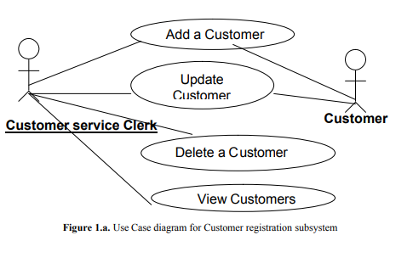
Use Case diagrams

Slide 10
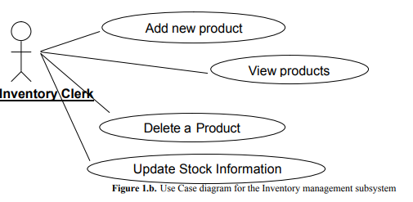

Slide 11
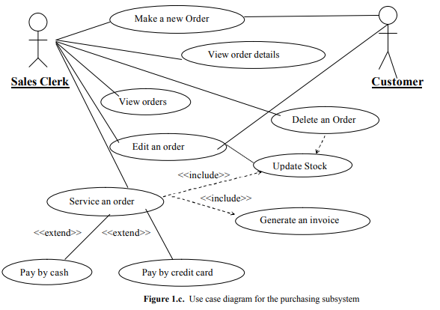

Slide 12
Class Diagrams
The class diagram is the most important entity in object oriented design.
It is very effective in showing what objects exists in the system and the static relationship between the classes.
It shows the relationships, roles and the navigability between the various existing entities.

Slide 13
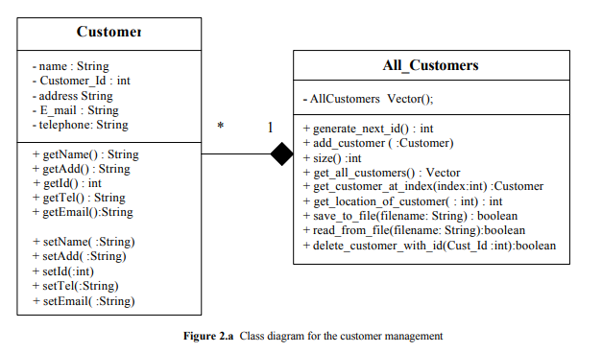

Slide 14
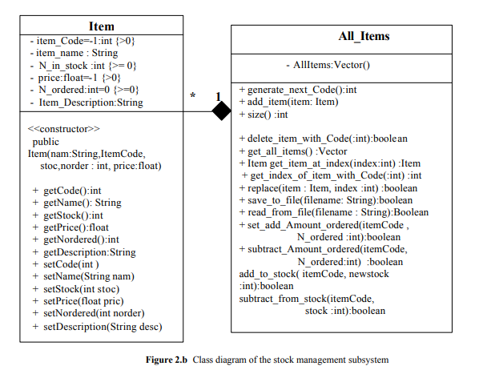

Slide 15
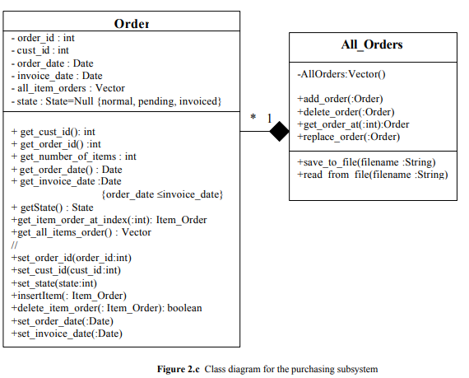

Slide 16
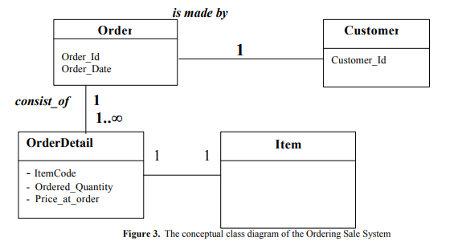

Slide 17
Contents
Basic Concepts of C++
Difference between C and C++
Applications of C++
How a program is Compiled?
Simple C++ Program

Slide 18
Basic Concepts of C++

Slide 19
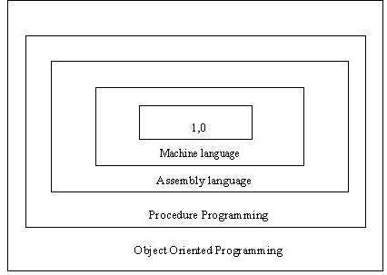
Basic Concepts of C++
Layers of Computer Software

Slide 20
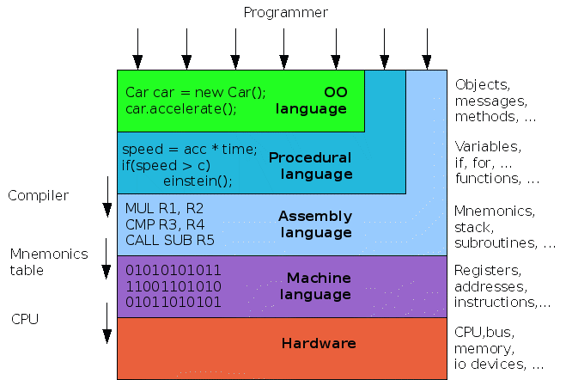
Basic Concepts of C++

Slide 21
Basic Concepts of C++
Object Oriented Programming is method of programming where a system is considered as a collection of objects that interact together to accomplish certain tasks. Objects are entities that encapsulate data and procedures that operate on the data.
In OOPS first a concept known as "Object Oriented Analysis (OOA)" is used to specify the objects in term of real world requirements, their behavior and interactions required. The next concept would be the "Object Oriented Design (OOD)" that converts these real-time requirements as a hierarchy of objects in terms of software development requirement. Finally OOPS is used to implement the requirements using the C++ programming language.
The main purpose of object oriented programming is to simplify the design, programming and most importantly debugging a program. So to modify a particular data, it is easy to identify which function to use. To add additional features it is easy to identify where to add functions and its related data.

Slide 22
Basic Concepts of C++
Object Oriented Programming Language
Basic Concepts:
Objects
Classes
Data Abstraction
Encapsulation
Inheritance
Polymorphism
Dynamic Binding
Message Passing

Slide 23
Objects
Basic runtime entity in an object – oriented system.
Often termed as “instance” of a class.
Example:
a person, a place, a bank account etc.
They can be of any type based on its declaration.
When program is executed, objects interact by sending messages at runtime.
Example 2:
Two objects namely, “customer”, “account”. Customer object may send a message to the account object requesting for bank balance.

Slide 24
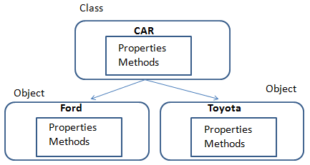
Classes
Class is a collection of objects of similar type.
Class is a way to bind the data and its associated functions together.
Objects are basically variable of the class or an object is an instance of a class.
Examples:
Shape is a class and Rectangle, Square, Triangle are its objects.

Slide 25
Abstraction
Providing only essential information to the outside world i.e. to represent the needed information in program without presenting the details.
Data abstraction is a programming/ design technique that relies on the separation of interface and implementation.
In C++, they provide sufficient public methods to the outside world to play with the functionality of the object and to manipulate object data, i.e., state without actually knowing how class has been implemented internally.
Eg: While using an object (that is an instance of a class) the built in data types and the members in the class are ignored. This is known as data abstraction.

Slide 26
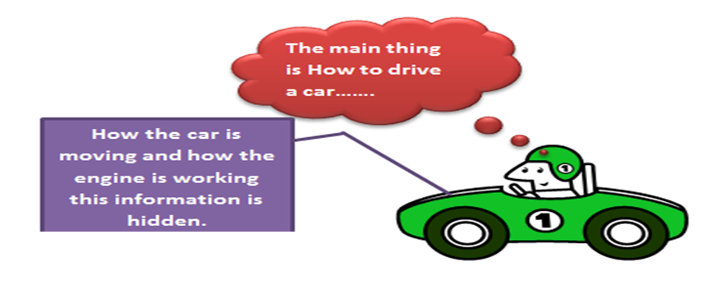
Abstraction

Slide 27
Encapsulation
All C++ programs are composed of the following two fundamental elements:
Program statements (code): This is the part of a program that performs actions and they are called functions.
Program data: The data is the information of the program which affected by the program functions.
Encapsulation is an Object Oriented Programming concept that binds together the data and functions that manipulate the data, and that keeps both safe from outside interference and misuse.
Data encapsulation led to the important OOP concept of data hiding.

Slide 28
Encapsulation
C++ supports the properties of encapsulation and data hiding through the creation of user-defined types, called classes.
Eg: a class can contain
private, protected, public members.

Slide 29
Inheritance
Inheritance works on the basis of re-usability.
This provides us an opportunity to reuse the code functionality and fast implementation time.
When creating a class, instead of writing completely new data members and member functions, the programmer can designate that the new class should inherit the members of an existing class. This existing class is called the base class, and the new class is referred to as the derived class.
The idea of inheritance implements the is a relationship.

Slide 30
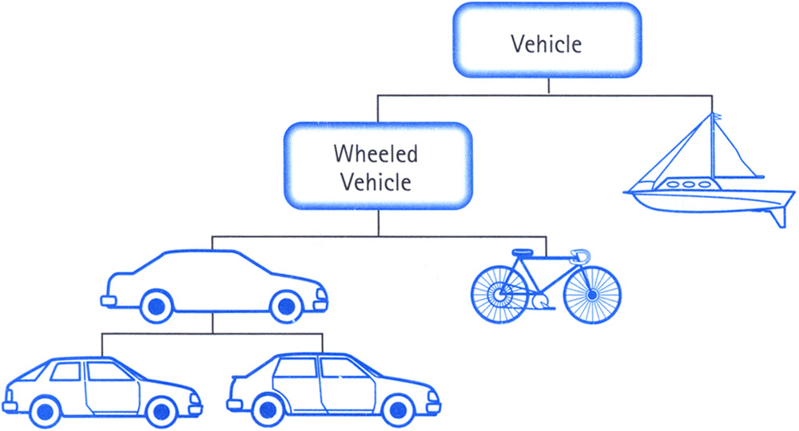
Inheritance

Slide 31
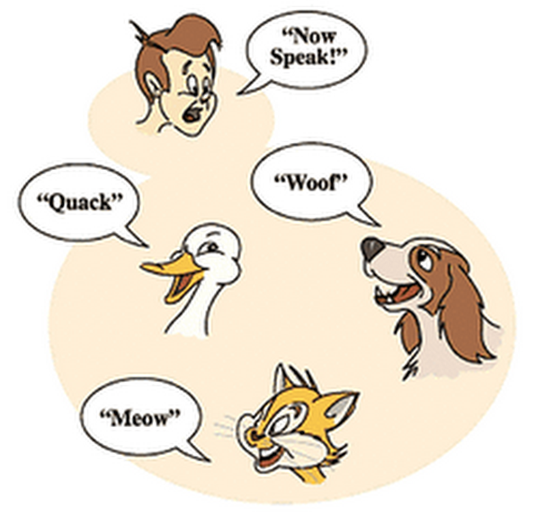
Polymorphism
Poly means many and morphism means changing or alterable.
The word polymorphism means having many forms.

Slide 32
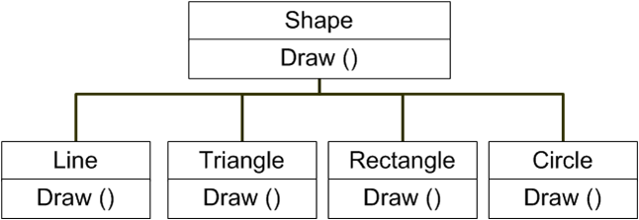
Polymorphism
C++ polymorphism means that a call to a member function will cause a different function to be executed depending on the type of object that invokes the function.

Slide 33
Dynamic Binding
Binding refers to the linking of a procedure call to the code to be executed in response to the call.
Dynamic binding (late binding) means that the code associated with a given procedure call is not known until the time of the call at run-time.
Associated with polymorphism and inheritance.

Slide 34
Message Passing
OOPs consists of a set of objects that communicate with each other.
This involves following steps:
Creating classes that define objects and their behavior
Creating objects from class definitions.
Establishing communication among objects
A message for an object is a request for execution of a procedure, and therefore will invoke a function (procedure) in the receiving object that generates the desired result.

Slide 35
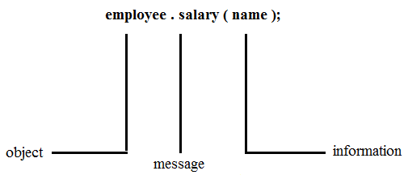
Message Passing
Message passing involves specifying the name of the object, the name of the function (message) and the information to be sent.

Slide 36
Difference between C and C++

Slide 37
Difference between C and C++
S. No. | Procedural Programming (C) | Object Oriented Programming (C++)
1 | Emphasis is on doing things (algorithms). | Emphasis is on data rather than procedure.
2 | Large programs are divided into smaller programs in the form of functions. | Programs are divided into objects. Functions that operate together are tied together in the data structure.
3 | Most of the functions share global data. | Data is mostly hidden and cannot be accessed by external functions.
4 | Data move openly around the system from function to function. Functions transform data from one form to another. | Objects may communicate with each other through functions. New data and functions can be easily added wherever necessary.
5 | Employs top-down approach in program design. | Follow bottom-up approach in program design.

Slide 38
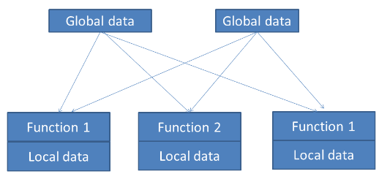
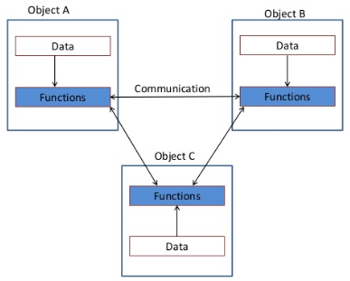
Difference between C and C++
Functioning of Procedural Language
Functioning of Object Oriented Programming Language

Slide 39
Difference between C and C++
A class is an extension of the idea of structure used in C.
A new way of creating and implementing user-defined data type.

Slide 40
C Structures
Provide a method for packing together data of different types.
A convenient tool for handling a group of logically related data items.
Eg:
struct student
{
char name[20];
int roll_no;
float total_marks;
} A;

Slide 41
Limitations
Cannot treat struct data-type like built in data type.
Example:
struct Complex
{
float x;
float y;
} c1, c2,c3;
Complex nos. c1, c2, c3 can be easily assigned values using dot operator, but we can’t directly add or subtract two complex nos. i.e.
c3 = c1 + c2; // illegal in C.
Do not permit data hiding. Structure members are public members.

Slide 42
C++ Classes
Attempts to bring user defined types as close as possible to the built-in data types.
Also provides facility to hide the data.
Inheritance is also supported by C++

Slide 43
Applications

Slide 44
Applications of OOPs Languages
Real-time systems
Simulation and Modeling
Object-oriented Databases
Hypertext and Hypermedia systems
AI and expert systems
Neural Networks and parallel programming
Decision Support and office automation systems
CIM/CAM/CAD systems

Slide 45
How a Program is Executed?

Slide 46
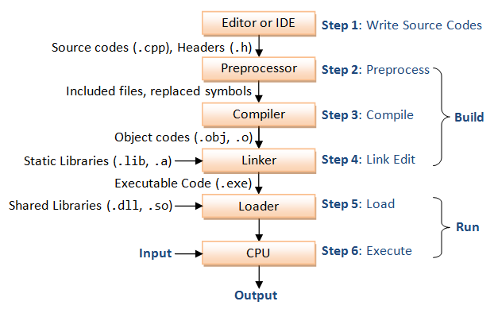
Flowchart

Slide 47
1. Editor
C++ program is written in an Editor.
Saved as a file with extension .cpp.

Slide 48
2. Preprocessor
Preprocessing performs (usually simple) operations on the source file(s) prior to compilation.
Typical preprocessing operations include:
(a) Expanding macros (shorthand notations for longer constructs). For example, in C,
#define abc(x,y) (3*x+y*(2+x))
In program n = abc(a,b) becomes
n = (3*a+b*(2+a))
(b) Inserting named ﬁles. For example, in C++,
# include <iostream>
is replaced by the contents of the ﬁle iostream.h

Slide 49
3. Compiler
Compiler is a program that can read a program in one language — the source language — and translate it into an equivalent program in another language — the target language or machine language.
An important role of the compiler is to report any errors in the source program that it detects during the translation process.

Slide 50
4. Linker
A linker combines object code (machine code that has not yet been linked) produced from compiling and assembling many source programs, as well as standard library functions and resources supplied by the operating system.

Slide 51
5. Loader
Compilers, assemblers and linkers usually produce code whose memory references are made relative to an undetermined starting location that can be anywhere in memory.
(relocatable machine code)
The loader then puts together all of the executable object files into memory for execution.
A loader calculates appropriate absolute addresses for these memory locations and amends the code to use these addresses.

Slide 52
6. Execute
CPU executes the program one instruction at time.

Slide 53
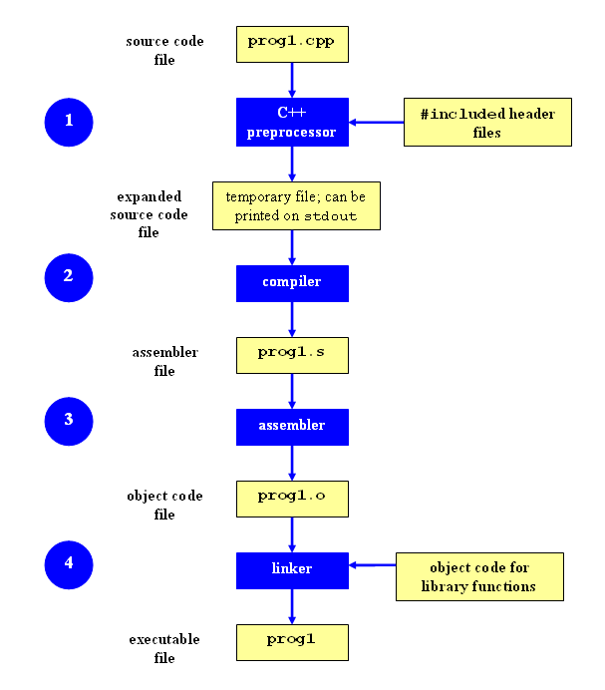
A Bit more about execution
1. To stop the process after the preprocessor step, you can use the -E option:
g++ -E prog1.cpp
The expanded source code file will be printed on standard output (the screen by default).

Slide 54
2. To stop the process after the compile step, you can use the -S option:
g++ -S prog1.cpp
By default, the assembler code for a source file named filename.cpp will be placed in a file named filename.s.

Slide 55
3. To stop the process after the assembly step, you can use -c option:
g++ -c prog1.cpp
By default, the assembler code for a source file named filename.cpp will be placed in a file named filename.o.

Slide 56
A simple C++ Program

Slide 57
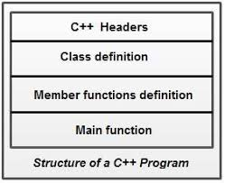
General Structure of C++ Program

Slide 58
“Hello World” in C++
Use the standard namespace
Include standard iostream classes
using namespace std;
#include <iostream>
// My first C++ program!
int main(void)
{
cout << "hello world!" << endl;
return 0;
}
A C++ comment
cout is an instance of iostream
operator overloading
(two different argument types!)

Slide 59
Thank You

